Slide 1
Immunization Supply Chain Management - BCU
EPI Managers Meeting - Central Africa Celestin Traore & Stephanie Lapière Sept 9, 2024

Slide 2






Outline
1
Big Catch up (BCU) 2024-2025 Supply Status in West & Central Africa
2
BCU application and Implementation recommendations
3
Monitoring doses BCU and Thrive360
4
2

Slide 3
Big Catch up plan (BCU) 2024-2025 Supply status in WCAR
Notes:
To address the imperative to plug growing immunity gaps, the “Big Catch-Up” initiative was launched in 2023. The three-pronged approach includes efforts to immunize those missed during the pandemic years, some of whom are now 5 years old; recovery of programme performance to reach the new birth cohort at least as well as before the pandemic; and, crucially, to rapidly improve programme reach to resume the trajectory towards 2030 goals.

Slide 4
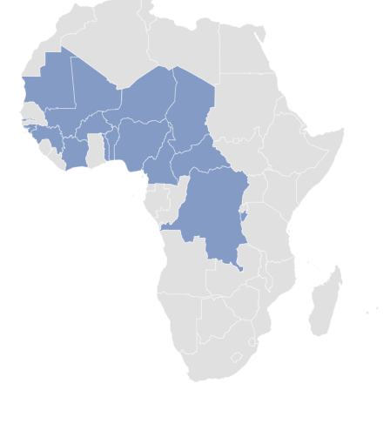
West & Central Africa Region (BCU) 2024-2025- Supply Status
16 countries submitted a BCU plan for additional doses. (85.5M doses)
Focus on 12 months – 59 months Zero Dose or Under-Vaccinated children.
Increasing volume of vaccines to be deliver to countries.

Slide 5
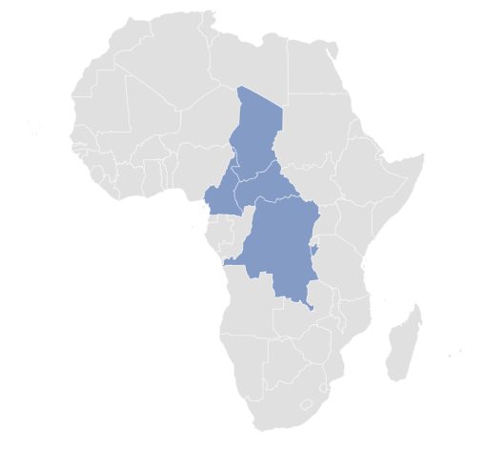

Central Africa Region - Essential Immunization Recovery plan (BCU) 2024-2025
5 countries submitted a BCU plan for additional doses. (54.5M doses)
Focus on 12 months – 59 months Zero Dose or Under-Vaccinated children.
Increasing the volume of vaccines and vaccine arrival in country.
Devices : syringes and safety boxes

Slide 6
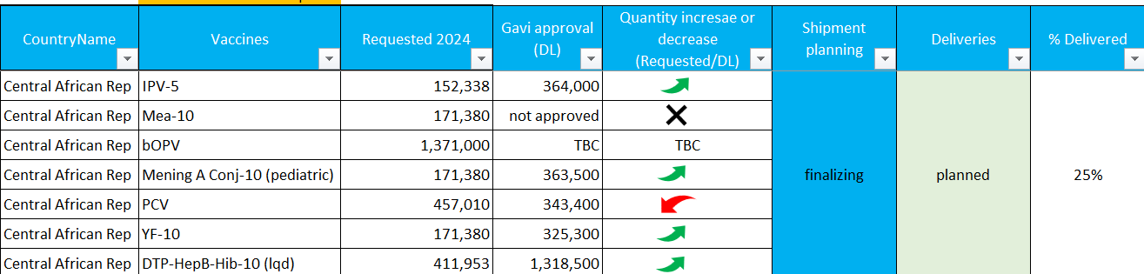
Central Africa Region – BCU (Sep 02, 2025)

Slide 7
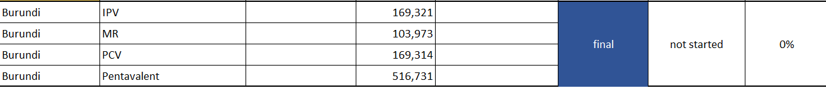
Central Region – BCU (Sep 02, 2025)

Slide 8
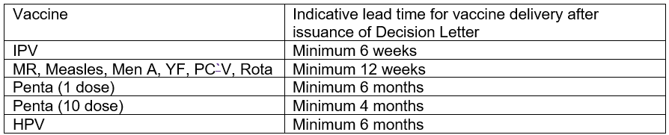
Central Region - (BCU) 2024-2025- Vaccines delivery lead time
No BCU implementation before validation of the shipment plan for Vaccines and Syringes
INDICATIVE LEAD TIMES

Slide 9
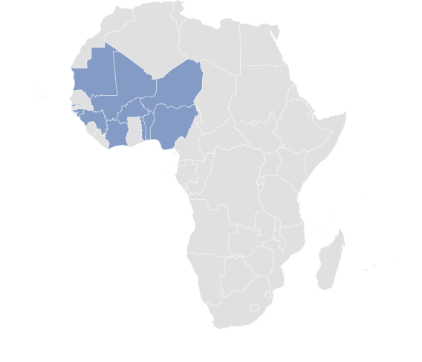
West Africa Region - (BCU) 2024-2025 -Supply Status
11 countries submitted a BCU plan for additional doses. (31M doses)
Focus on 12 months – 59 months Zero Dose or Under-Vaccinated children.
Increasing the volume of vaccines and vaccine arrival in country.
Devices : syringes and safety boxes

Slide 10
West Africa Region – BCU (Sep 02, 2025)

Slide 11
West Africa Region – BCU (Sep 02, 2025)

Slide 12
West Region – BCU (Sep 02, 2025)

Slide 13
West Africa Region – BCU (Sep 02, 2025)

Slide 14
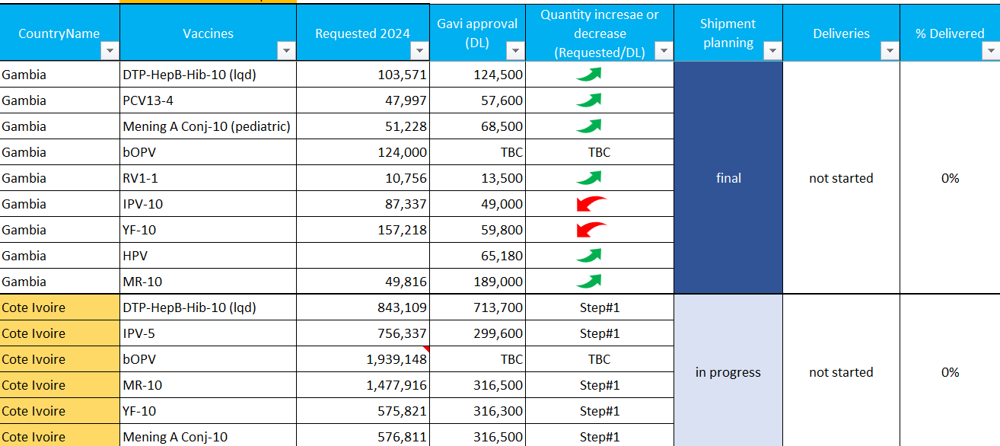
West Africa Region – BCU (Sep 02, 2025)

Slide 15
West Africa Region -(BCU) 2024-2025- Vaccine delivery lead time
No BCU implementation before validation of the shipment plan for Vaccines and Syringes
INDICATIVE LEAD TIMES

Slide 16
BCU application and Implementation recommendations

Slide 17


BCU Supply Planning and review challenges
Long process to align narrative BCU plan and BCU vaccines quantification : miss alignment between the guidance, target populations and vaccines forecasting → Consequences : delay in the submission and long approval process.
Doses approval (Gavi’s DLs) in some countries are different from the plan (included 2024 and 2025 request, increased or reduced ) → The implementation plan should be adjusted according to the approval of the doses.

Slide 18
Recommendations for Implementation
No BCU implementation before validation of the shipment plan for Vaccines and Syringes
BCU implementation is critical and BCU doses utilization are for BCU target → Monitoring of consumption should be implemented to avoid utilization of the BCU doses into routine target group
Country should report monthly stock BCU vaccines doses into the same monthly mechanism as routines doses → Thrive360

Slide 19
Thrive360 and Monitoring BCU doses

Slide 20
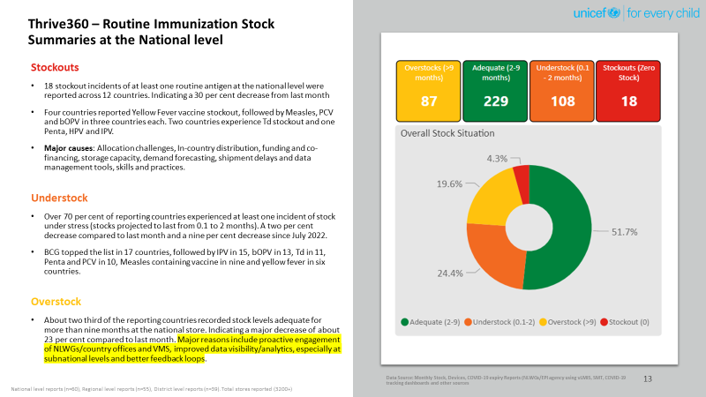
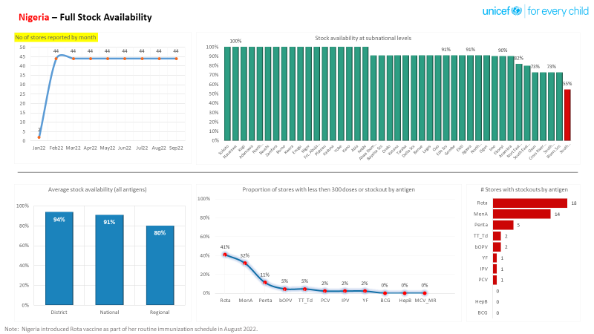
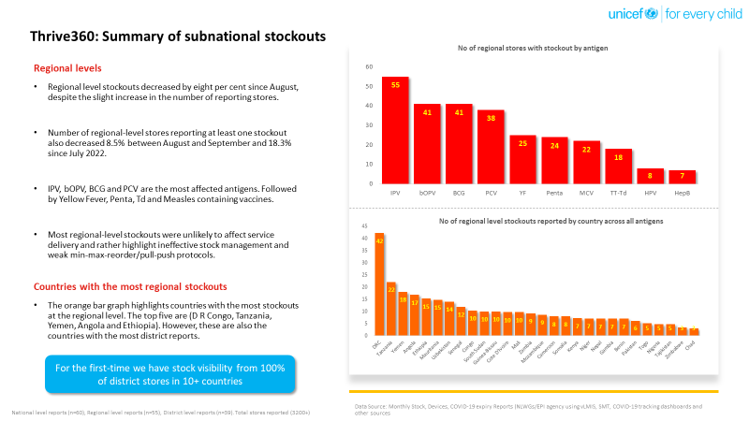
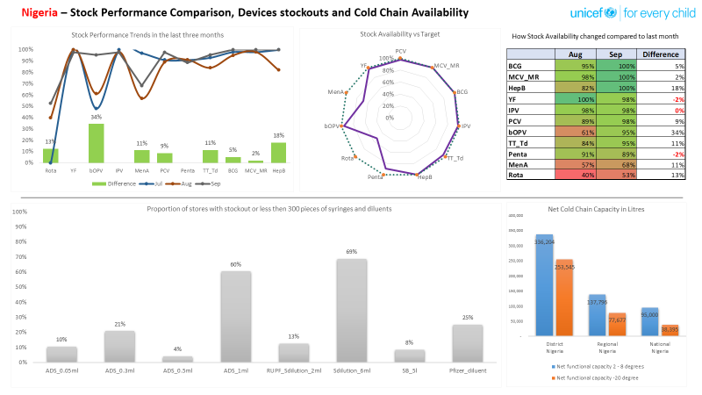
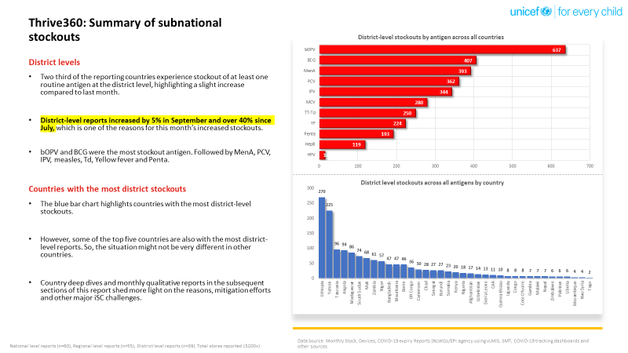
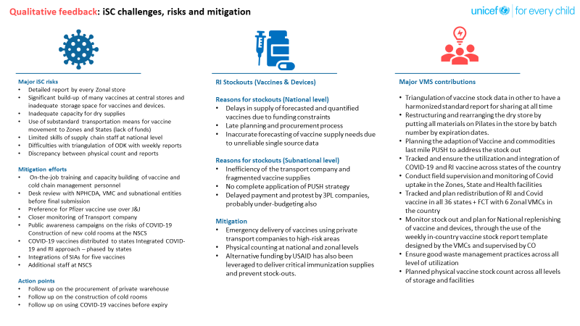
Monthly in-depth analysis at global and country level
Data hub converging country immunization data in a single platform
Global, national, regional and district level stock performance snapshots.
Data-driven planning and decision-making at several iSC levels
Integration and triangulation (SMT, eLMISs, WUENIC, EVM, JRF, Zero-dose, COVID19)
In-depth analysis, visualization and profiling
Monthly view of stock risky situations at national, regional, and district levels
Feedback on each report to regional and country offices and NLWGs/EOCs.
Corrective measures, improvement tracking.

Slide 21
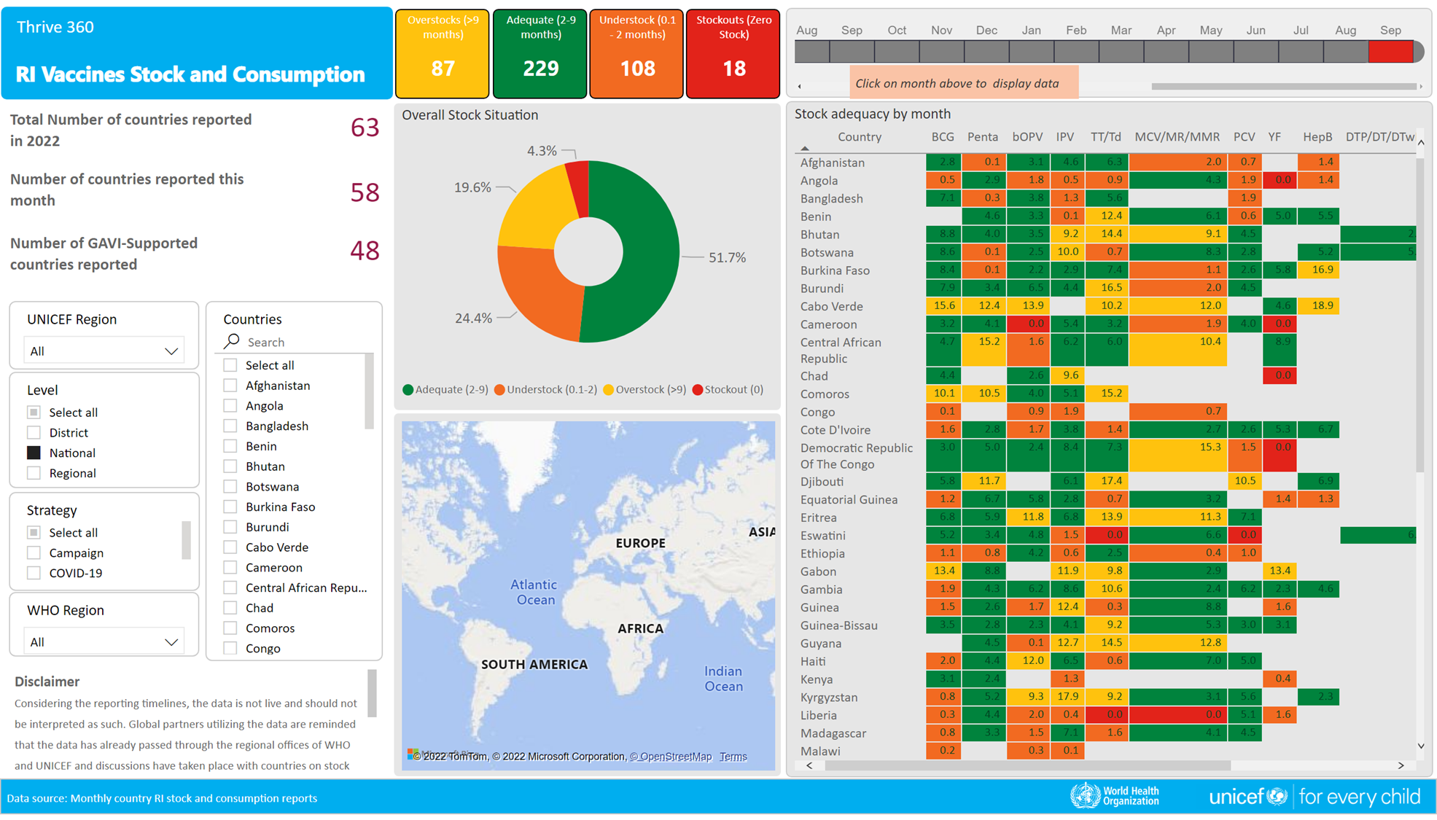
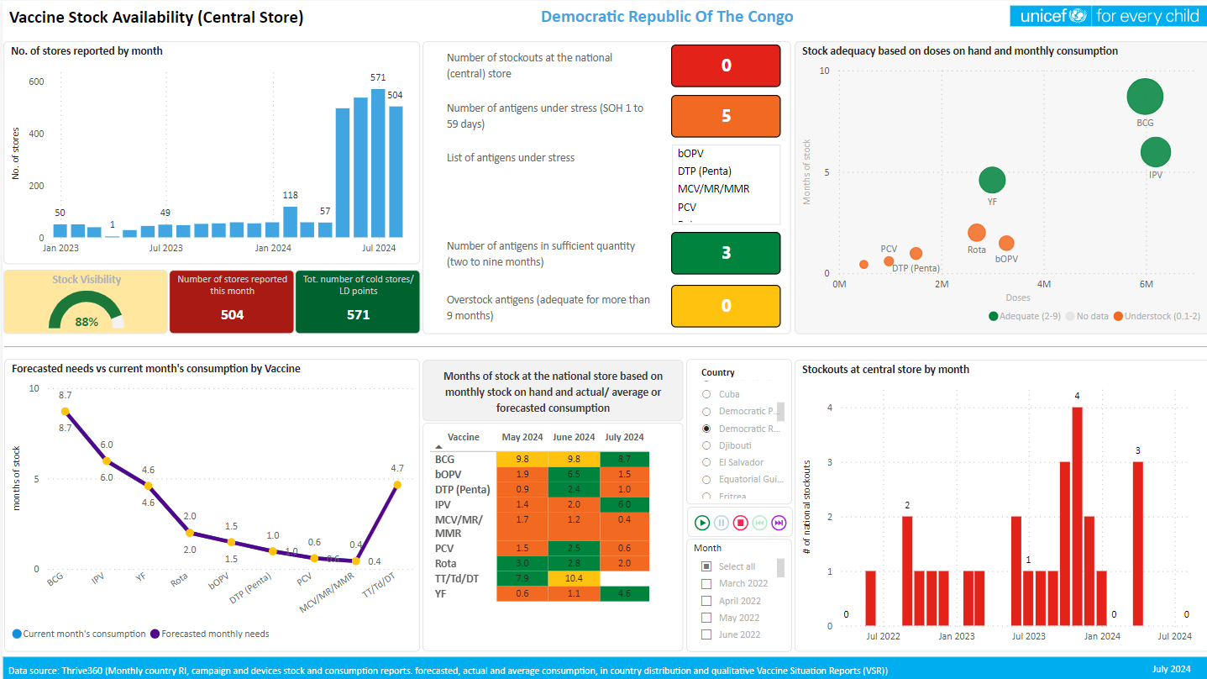
RI Vaccine Stocks
Thrive360 Stock Summaries
Global, country and anti-gen wise stock summaries, months of stock, stockouts and overstocking incidents on monthly basis.
Routine immunization
Geographic level filters
Thrive360 Stock Trends
Antigen and country-wise stock performance trends.
Ability to filter, drill-down or up and cross-filter
A much better stock management picture compared to just monthly single point data

Slide 22
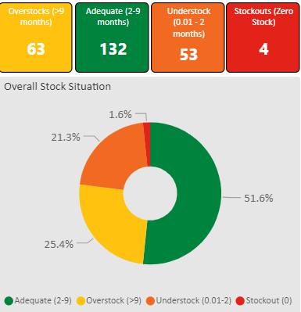
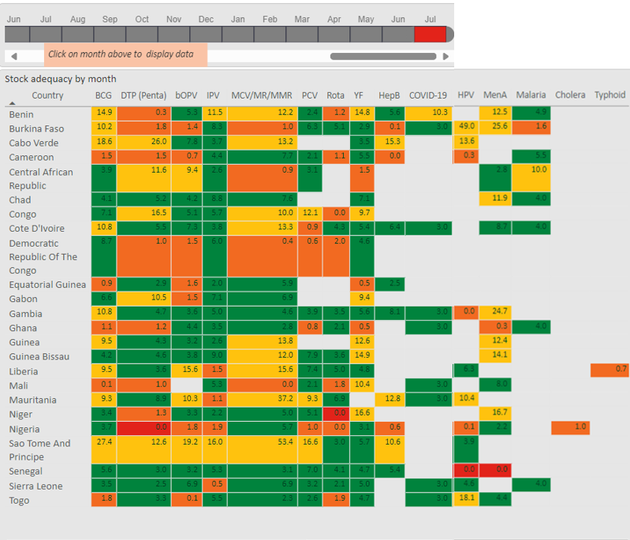
Immunization Stock management : Thrive360 (July 2024)
Country should report monthly stock BCU vaccines doses into the same monthly mechanism as routines doses → Thrive360
Thrive360 - Power BI

Slide 23


Thank you.
© UNICEF/UN0216133

